Slide 1
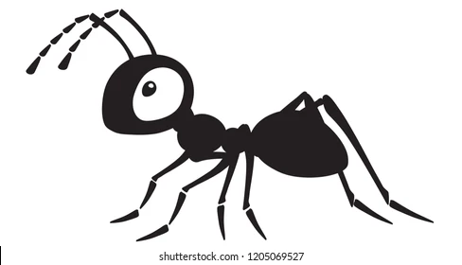
Brood sorting by ants
Ludi van Leeuwen
Corine Nijhof
Advanced Self-Organisation of Social Systems

Slide 2
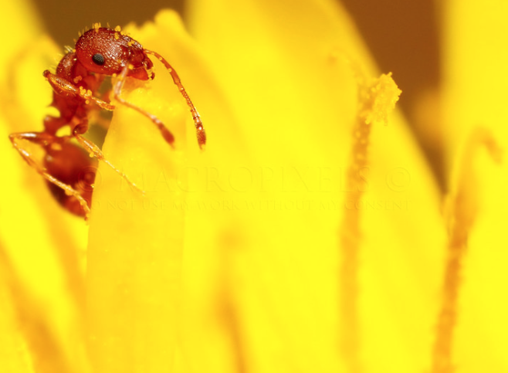
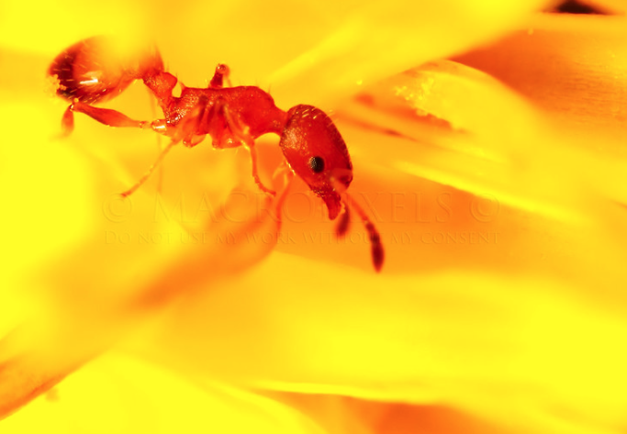
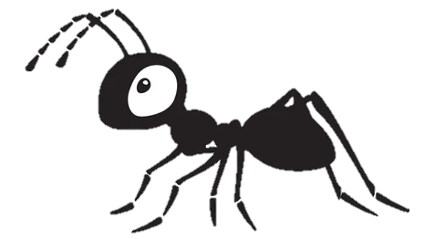
Main character
Notes:
https://www.antkeepers.com/facts/ants/egg-to-ant/

Slide 3
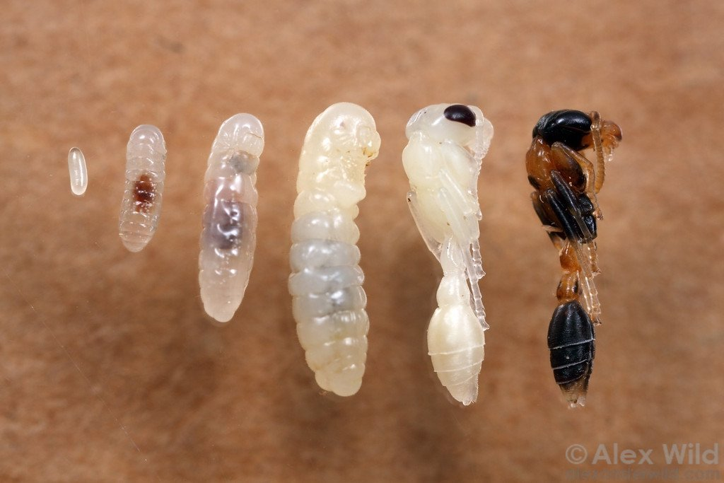
Family picture
Egg
medium
large
pre-pupae
pupae
Notes:
https://www.antkeepers.com/facts/ants/egg-to-ant/

Slide 4
Empirical data (Sendova-Franks 2004)
Brood is sorted in concentric annuli (rings)
Eggs and small larvae
Medium larvae
Large larvae
Prepupae
Pupae
Notes:
https://www.antkeepers.com/facts/ants/egg-to-ant/

Slide 5
Question
What is the cause of this brood organisation?
initial state after migration
brood sorting occurs very fast
pupae
large
prepupae
prepupae
medium
pupae
large
medium
Notes:
https://www.antkeepers.com/facts/ants/egg-to-ant/

Slide 6
Alternative hypotheses
Clustering (Deneubourg, 1991)
pupae
pupae
Caused by: dropping near others of same type.
Clusters, not concentric annuli!
pupae
medium
prepupae
medium
medium
small
large
prepupae
small
small
large
small
large
Notes:
https://www.antkeepers.com/facts/ants/egg-to-ant/

Slide 7
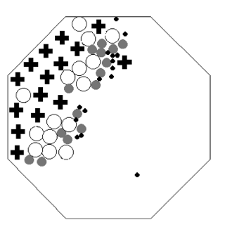
Alternative hypotheses
Muesli effect (Barker & Grimson, 1990)
large
Small items can pass, larger can’t
large
Empirical results (by simulated robots)
large
medium
medium
No concentric annuli!
medium
medium
small
small
small
small
small
small
Wilson (2004)
Notes:
https://www.antkeepers.com/facts/ants/egg-to-ant/

Slide 8
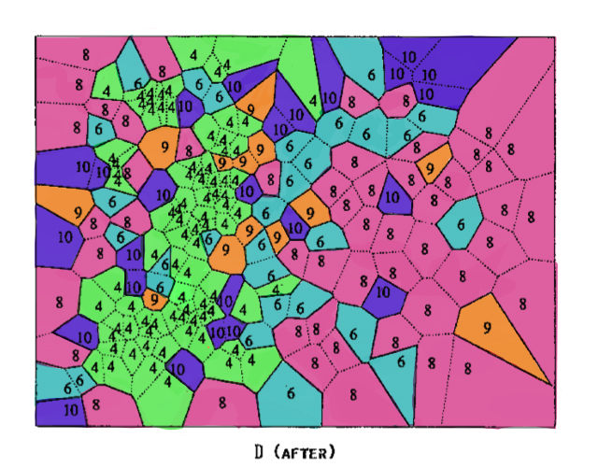
Sendova and Franks Hypothesis
Differential diffusion - each brood type is spaced out according to its domain of care.
Eggs and small larvae
Medium larvae
Large larvae
Prepupae
Pupae
Franks (1992)

Slide 9
Hypothesis
Domain of care ~ to amount of care that brood needs
Eggs and small larvae
Medium larvae
Large larvae
Prepupae
Pupae
Eggs, pupae and prepupae are clustered very close together, medium and large larvae are on the outside, and need more space.

Slide 10
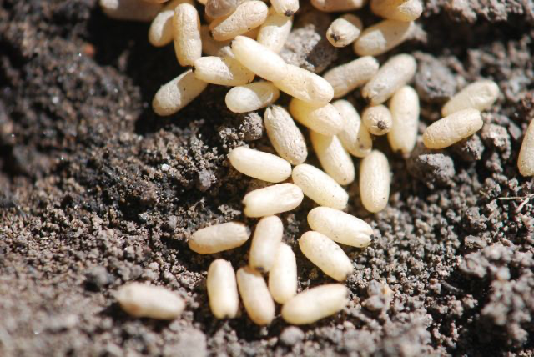

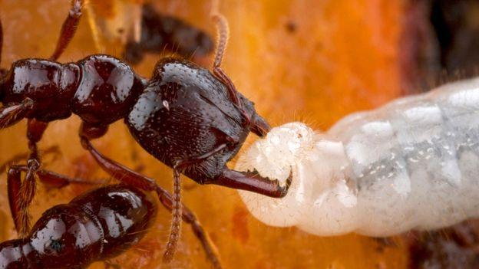
Hypothesis
Domain of care ~ to amount of care that brood needs
Care eggs and larvae: Feeding and cleaning
Care (Pre)-Pupae: No feeding, only cleaning
for illustration purposes only - this is not the right species of ant

Slide 11
Hypothesis
Care ordering: Large larvae > Medium larvae ~ Prepupae ~ Pupae > Small larvae and eggs.
Evolutionary explanation: more energy invested in large larvae, hence need more care.

Slide 12
Hypothesis
Care ordering: Large larvae > Medium larvae ~ Prepupae ~ Pupae > Small larvae and eggs.
Simple rules:
Pick brood up if overcrowded according to domain of care.
Drop brood if not overcrowded anymore.

Slide 13
Hypothesis
Care ordering: Large larvae > Medium larvae ~ Prepupae ~ Pupae > Small larvae and eggs.
Simple rules:
Pick brood up if overcrowded according to domain of care.
Drop brood if not overcrowded anymore.
+ tiredness - ants carry small/light brood easier than large/heavy brood.

Slide 14
Model
Ants
Larvae
Carry
Pick up if not enough room around larva
Drop when enough room or ant too tired
Energy
Vision
Speed
Pick-up range
Tiredness
Type
Weight
Care domain
Pheromones

Slide 15
Model
Ants
Larvae
Carry
Pick up if not enough room around larva
Drop when enough room or ant too tired
Energy
Vision
Speed
Pick-up range
Tiredness
Type
Weight
Care domain
Pheromones
small
medium
large
prepupae
pupae

Slide 16
Model
Ants
Larvae
Carry
Pick up if not enough room around larva
Drop when enough room or ant too tired
Energy
Vision
Speed
Pick-up range
Tiredness
Type
Weight
Care domain
Pheromones
small 0.40522
medium 2.62807
large 7.41487
prepupae 5.92974
pupae 5.83200

Slide 17
Model
Ants
Larvae
Carry
Pick up if not enough room around larva
Drop when enough room or ant too tired
Energy
Vision
Speed
Pick-up range
Tiredness
Type
Weight
Care domain
Pheromones
small 1.0
medium 3.5
large 5.0
prepupae 2.5
pupae 2.0

Slide 18
Model
Ants
Larvae
Carry
Pick up if not enough room around larva
Drop when enough room or ant too tired
Energy
Vision
Speed
Pick-up range
Tiredness
Type
Weight
Care domain
Pheromones

Slide 19
Model
Ants
Larvae
Carry
Pick up if not enough room around larva
Drop when enough room or ant too tired
Energy
Vision
Speed
Pick-up range
Tiredness
Type
Weight
Care domain
Pheromones
time of carrying * weight

Slide 20
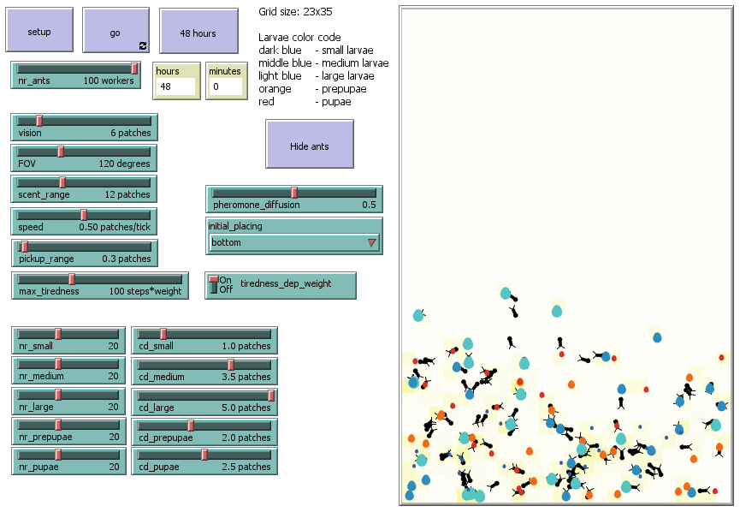
Model demonstration
Notes:
Show model by screensharing

Slide 21

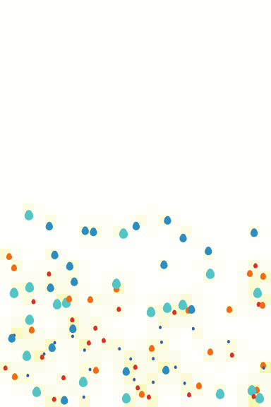

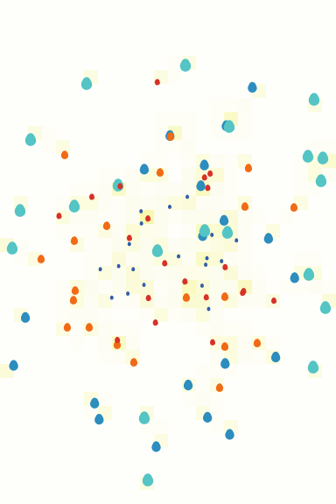
Initial placing bottom vs. center

Slide 22
Initial placing bottom vs. center

Slide 23
Initial placing bottom vs. center

Slide 24
Care domain
proportional to weight vs. equal
Notes:
equal cd = 2.5

Slide 25
Care domain
proportional to weight vs. equal for all larvae
Notes:
equal cd = 2.5

Slide 26
Tiredness
dependent on weight vs. equal for all larvae
Notes:
equal cd = 2.5

Slide 27
Tiredness
dependent on weight vs. equal for all larvae
Notes:
equal cd = 2.5

Slide 28
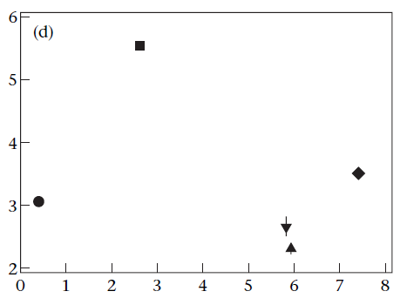
RMS of brood displacement
model vs. empirical (Sendova-Franks, 2004)
Root mean square displacement of brood (mm)
Weight of larvae (length³ mm)
Notes:
absolute values: blue
trend: grey

Slide 29
RMS of brood displacement
model vs. empirical
Root mean square displacement of brood (mm)
Weight of larvae (length³ mm)
Notes:
maximum tiredness = 50

Slide 30
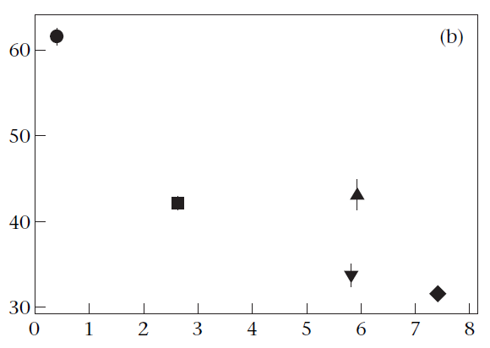
Mean duration of brood movement by ants
model vs. empirical
Mean duration of movement (s)
Weight of larvae (length³ mm)

Slide 31
Mean duration of brood movement by ants
model vs. empirical
Mean duration of movement (s)
Weight of larvae (length³ mm)

Slide 32
Summary of results
 | Answer | Significance
Does sorting occur? | Yes – difference in position between different types of larvae | F(4, 288095) = 32482, p < 0.05*** Adjusted for multiple comparisons
Does care domain affect sorting? | Yes – with equal care domains of larvae sorting happens only based on weight | MANOVA F(5, 144044) = 14575, p < 0.05***
Does tiredness affect sorting? | Yes – with equal tiredness for larvae sorting is less clear | MANOVA F(5, 144044) = 237, p < 0.05***

Slide 33
Conclusion
Model shows
Different care domains cause brood sorting
Tiredness is less important than care domain in resulting brood sorting
Lighter larvae can be carried longer, but aren’t because of small care domain

Slide 34
Discussion
Model agrees with article on
Larvae with more weight can be carried less far
Larvae with bigger care domain end up more towards periphery
Structure!
Model disagrees with article on
Even though small larvae can be carried further, they aren’t
Probable cause: small larvae are already “happy” where they are due to their small domain of care

Slide 35
Further research
We took “domain of care” as a primitive, but can we get “domain of care” to emerge by modelling food requirement and cleaning requirements directly?
Sendova and Franks discuss 2 different phases: 1 of direct, tight clustering, and 2 of spacing out - we only modelled phase 2 - can we model both phases?

Slide 36
References
Franks, N. R. & Sendova-Franks, A. B. 1992. Brood sorting by ants: distributing the workload over the work-surface. Behavioral Ecology and Sociobiology, 30, 109–123.
Sendova-Franks, A. B. et al. “Brood sorting by ants: two phases and differential diffusion”. Animal Behaviour, 68 (2004): 1095 - 1106. https://doi.org/10.1016/j.anbehav.2004.02.013
Wilson, M. et al. “Algorithms for Building Annular Structures with Minimalist Robots Inspired by Brood Sorting in Ant Colonies.” Autonomous Robots 17 (2004): 115-136.

